Slide 1
Fake news detection using machine learning Algorithms
Developed By
Name | ID | Intake
Sadia Afrin | 18192103146 | 41
Md. Masudul Islam Asif | 18192103147 | 41
Md. Tahmid Hossain Rasel | 18192103168 | 41
Tahmina Akhter | 18192103225 | 41
Jannatul Ferdous Tonni | 17182103264 | 38
Supervised By
Md. Raisul Alam
Assistant Professor
Department of CSE

Slide 2
Introduction
The rapid growth of social media and online platforms has led to the widespread spread of fake news, posing a serious threat to information integrity. Detecting and combating fake news has become a serious challenge in the digital age.
This study aims to address this problem in the specific context of Bengali language to develop an accurate and reliable fake news detection system in Bengali using machine learning algorithms. Because Bengali is widely spoken, fake news has negative consequences that can lead to misinformation and social unrest. Bengali's unique language and cultural background create unique challenges to effectively detect fake news. However, recent advances in machine learning and natural language processing techniques offer promising opportunities for developing robust detection systems.

Slide 3

Objectives
To develop an accurate and reliable Bangla fake news detection system by leveraging the best-performing machine learning algorithm(s) identified through the comparative analysis.
To evaluate the effectiveness and comparative performance of machine learning algorithms, namely Support Vector Machines (SVM), Decision Trees (DT), and Naive Bayes, in detecting fake news in the Bangla language.
To investigate and identify the strengths, weaknesses, and limitations of each machine learning algorithm (SVM, DT, and Naive Bayes) in the specific context of Bangla fake news detection.

Slide 4
Literature Review
Zobaer et al. provide an analysis of the dataset and develop a benchmark system with state-of-the art NLP techniques to identify Bangla fake news. To create this system, they explored traditional linguistic features and neural network-based methods.
Gulzar et al. have used two supervised machine learning algorithms, Multinomial Naive Bayes (MNB) and Support Vector Machine (SVM) classifiers to detect Bangla fake news with CountVectorizer and Term Frequency - Inverse Document Frequency Vectorizer as feature extraction.
Shahariar at al. demonstrate a comparison between the performance of traditional machine learning, deep learning, and transfer learning models on Ben-Sarc corpus. Transfer learning using Indic-Transformers Bengali BERT as a pre-trained source model has achieved the highest accuracy of 75.05%. The second highest accuracy is obtained by the LSTM model with 72.48% and Multinomial Naive Bayes is acquired the third highest with 72.36% accuracy for deep learning and machine learning, respectively.

Slide 5
Using Software and Hardware
Hardware
Windows (10 pro version)
Intel(R) Core(TM) i5-8265U CPU @ 1.60GHz 1.80GHz with a Core i5 and
8 GB of RAM.
Software-
Google Colab
Libraries

Slide 6
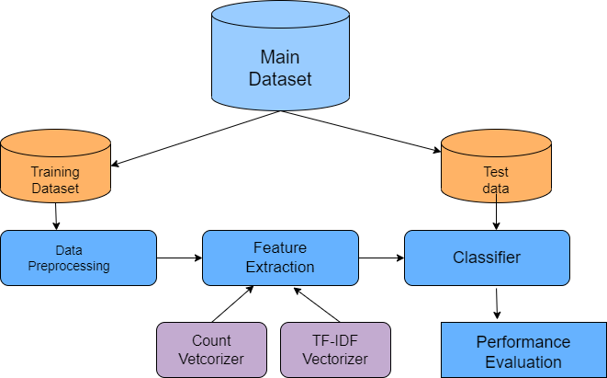
Proposed Model

Slide 7
Different machine learning algorithms
Support Vector Machine
SVM is a supervised machine learning model that uses classification algorithms. SVM is capable of doing both classification and regression.
Decision Tree
Decision Tree is a Supervised learning technique mostly used for solving classification problems. Decision Tree is a binary tree that recursively keeps splitting the dataset until it finds pure leaf.
Naïve Bayes
Naive Bayes classifiers are the part of simple machine learning. Naive Bayes is popular algorithm which is used to find the accuracy of the news whether its real or fake using multinomial NB and pipelining concepts.

Slide 8
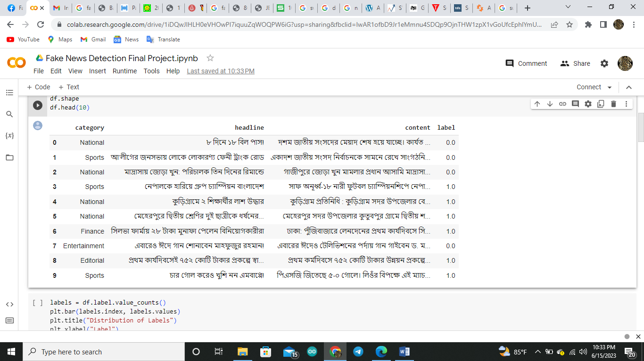
Dataset

Slide 9
Accuracy
Model | Classification Accuracy
Decision Tree Classifier | 67%
Support Vector Machine(SVM) | 75%
Naïve Bayes | 69%

Slide 10
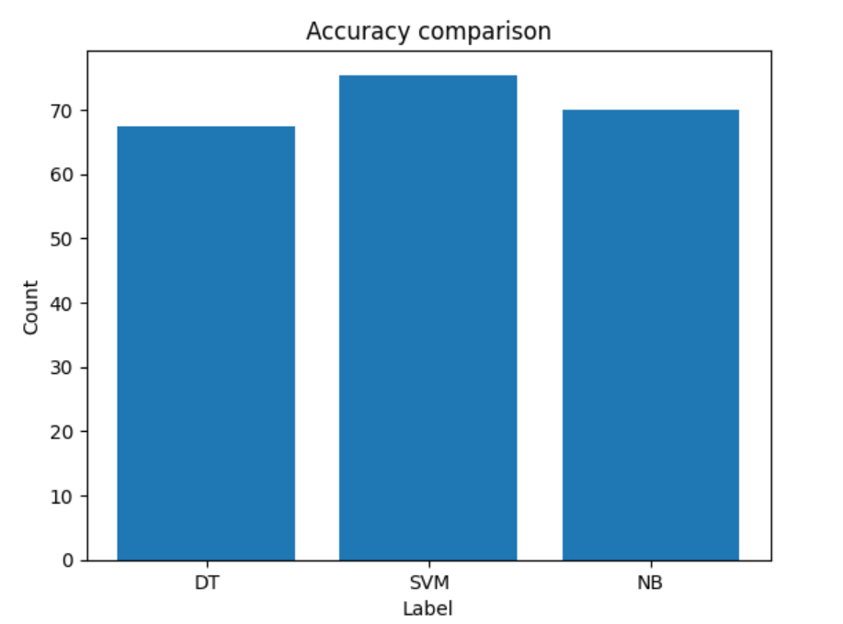
Accuracy Comparison Plot

Slide 11
Results with different Classifiers
Name of model | Accuracy | precision | Recall | F1 score
Decision Tree Classifier | 0.673658872077028 | 0.75 | 0.77 | 0.76
Support vector machine | 0.750687757909215 | 0.75 | 0.93 | 0.83
Naive Bayes | 0.693603851444291 | 0.69 | 1.00 | 0.81

Slide 12
limitations
Extracting informative features from Bangla text can be challenging due to the language's unique characteristics. The algorithms may struggle to effectively capture and represent the linguistic nuances specific to Bangla, such as sentiment analysis, semantic cues, and cultural references, resulting in suboptimal performance.
The availability of labeled datasets specifically for Bangla fake news detection is limited compared to other languages. The scarcity of high-quality labeled datasets hampers the training and evaluation of models, potentially limiting their performance and generalizability.

Slide 13
Future Enhancement
To improve the performance of fake news detection, future work can focus on the following aspects:
Dataset Collection: Collecting a large and diverse dataset of Bangla fake news articles, along with their corresponding reliable sources, is crucial. This will help in training more robust and accurate models.
Ensemble Methods: Combining the predictions of multiple models using ensemble methods, such as bagging or boosting, can lead to improved performance.
Deep learning models, such as Convolutional Neural Networks (CNNs) and Recurrent Neural Networks (RNNs), can capture complex patterns and dependencies in textual data. Integrating these models into the fake news detection pipeline could potentially improve the accuracy and robustness of the system.

Slide 14
Conclusion
In conclusion, the application of machine learning algorithms, such as decision trees, Support Vector Machines (SVM), and Naive Bayes, for Bangla fake news detection shows promising results. These algorithms can be utilized to build models that can effectively identify fake news in the Bangla language.
The decision tree algorithm is a powerful tool for classification tasks, including fake news detection.
SVM is another popular algorithm that works well for both linear and non-linear classification tasks. It uses a kernel function to map the data into a higher-dimensional feature space, where a hyperplane is constructed to separate the classes.
Naive Bayes is a probabilistic algorithm based on Bayes' theorem and assumes that features are independent of each other.

